Slide 1



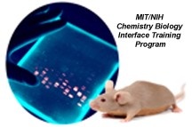

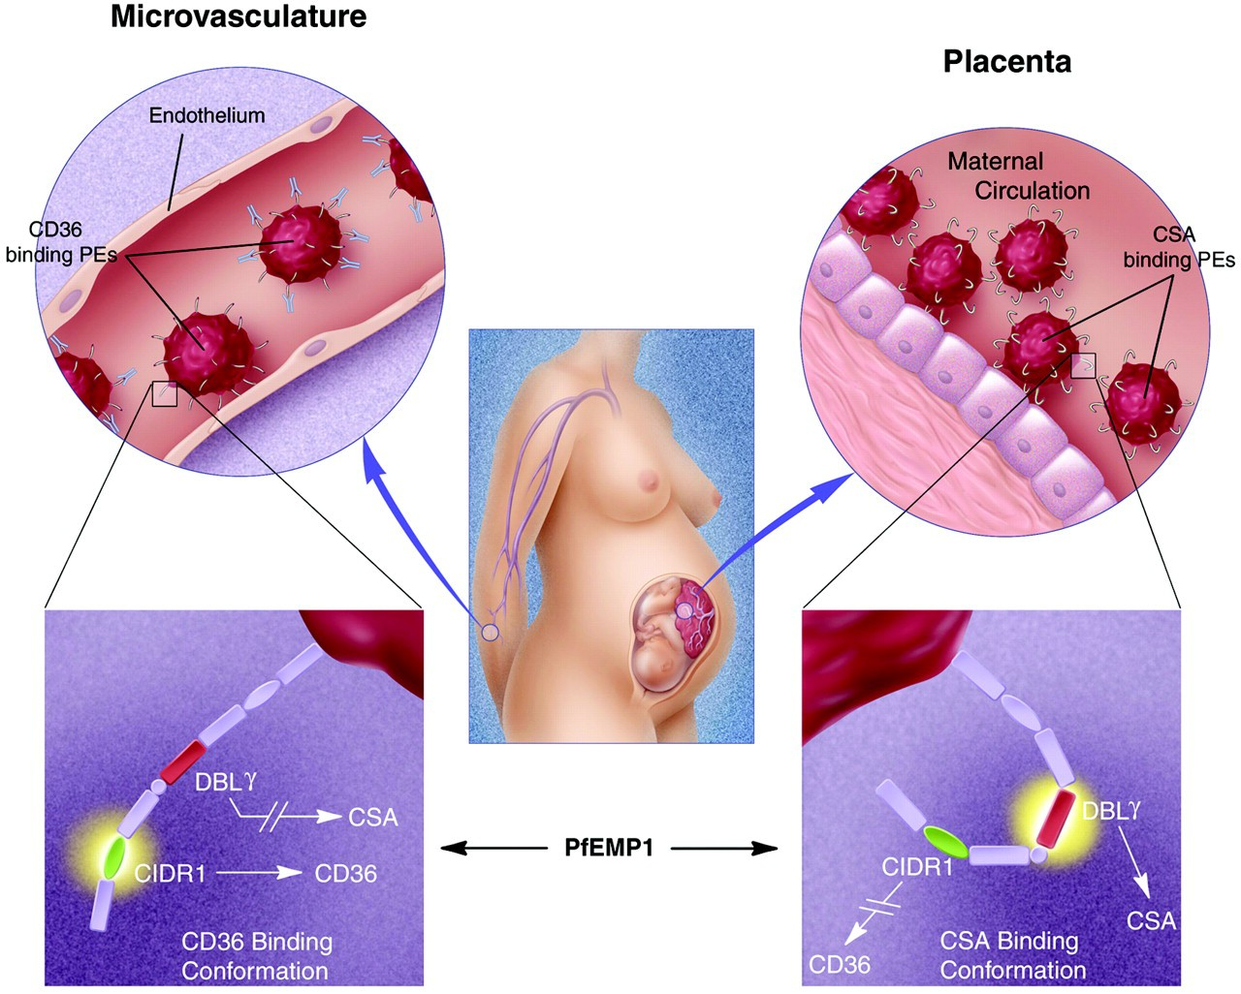
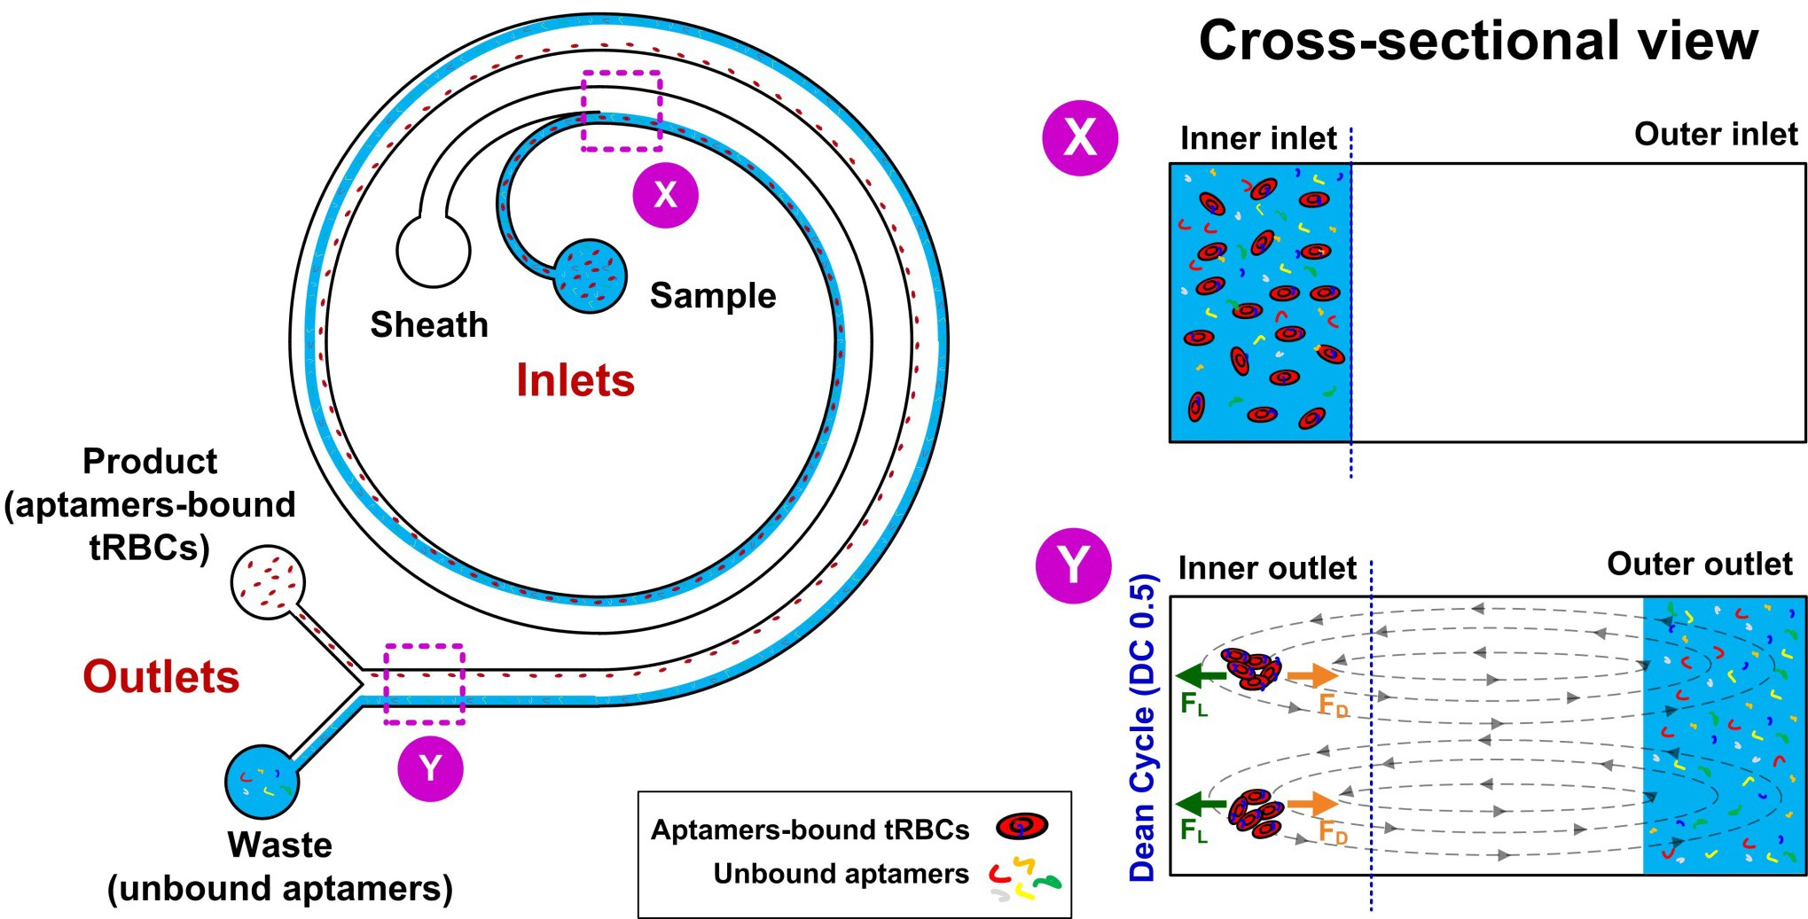
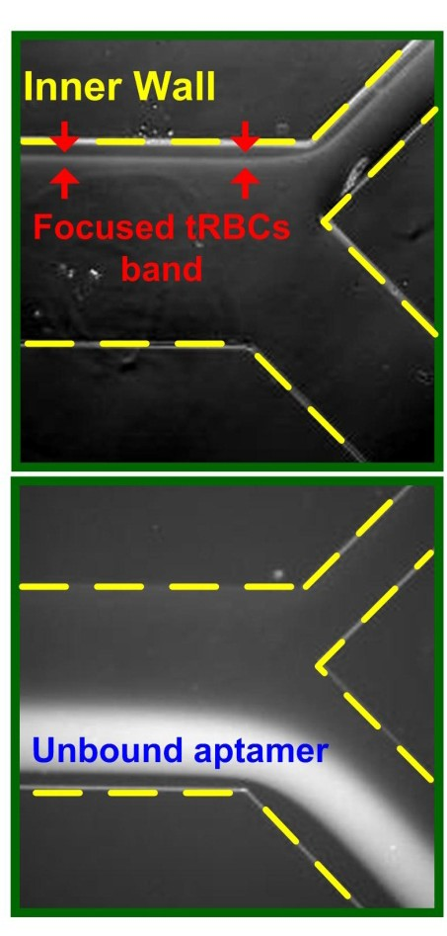
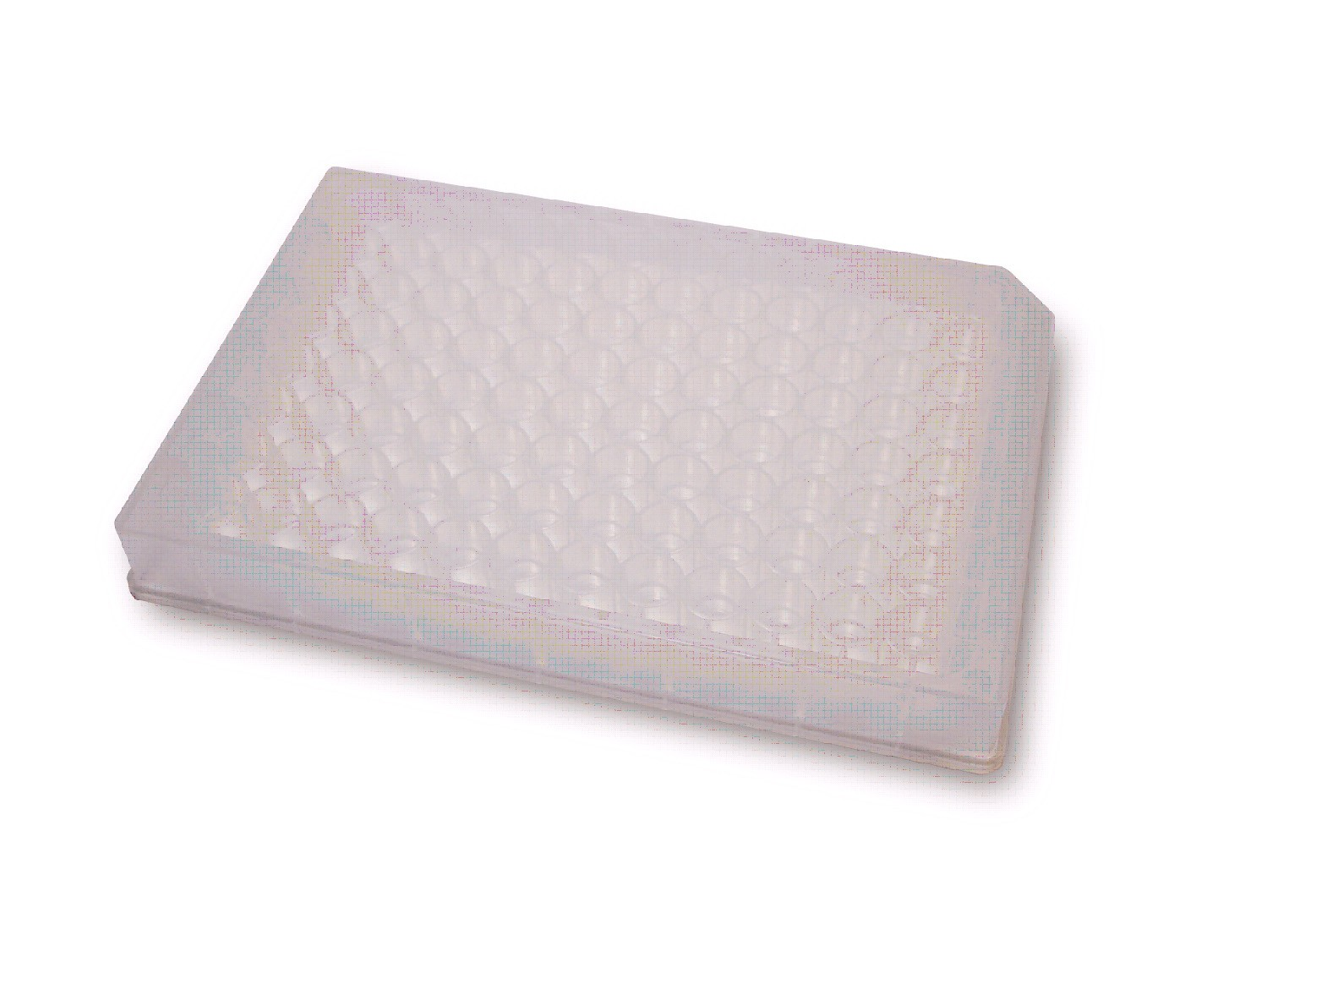
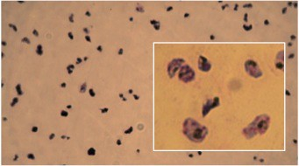
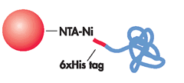
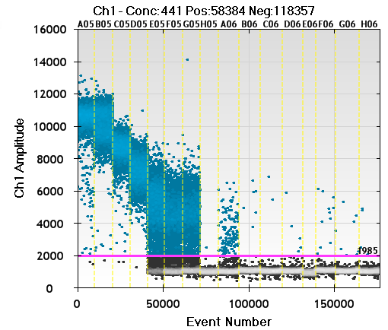
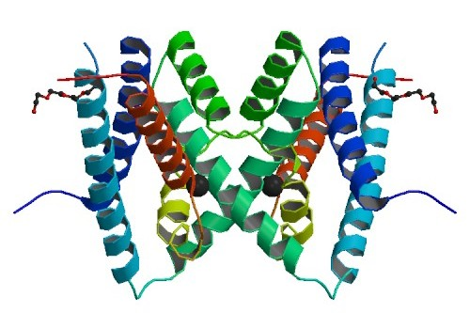
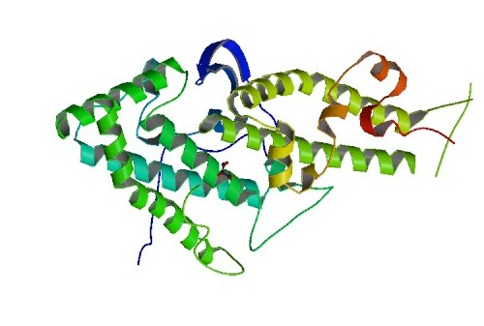
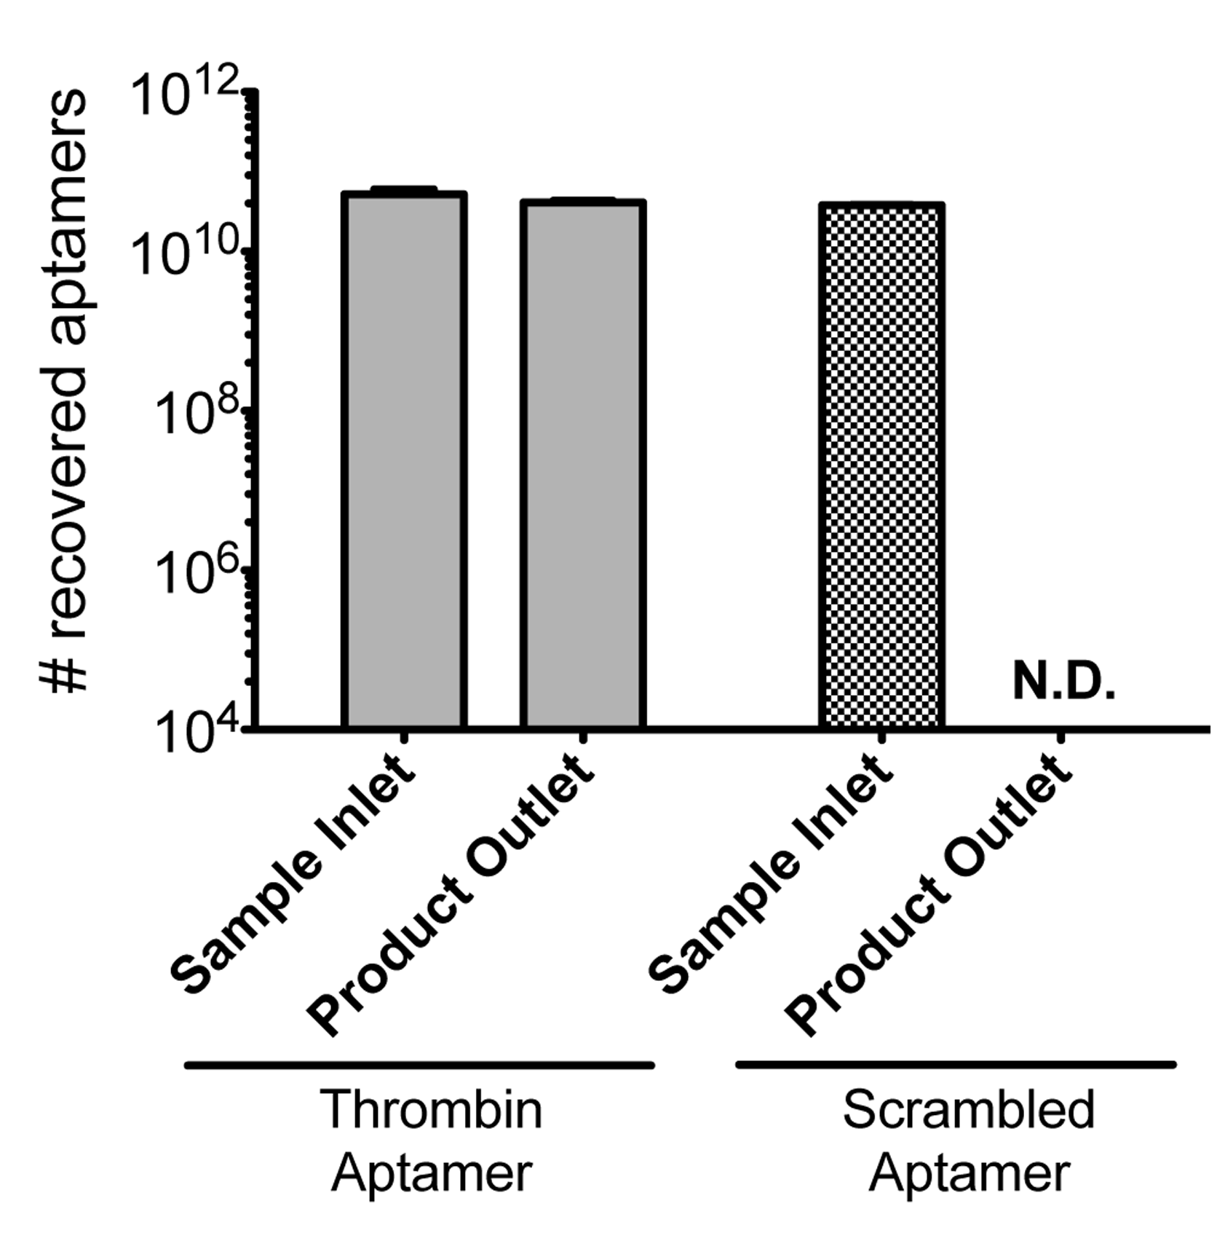
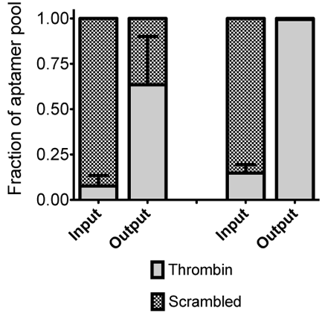


















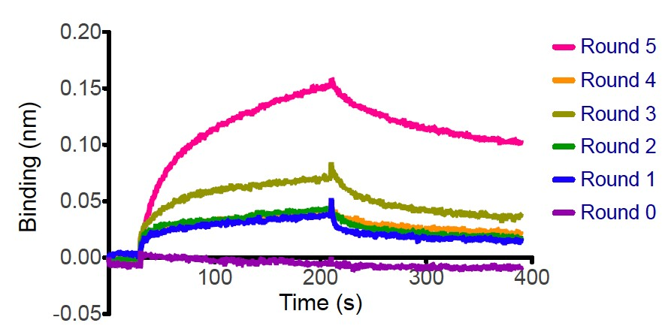














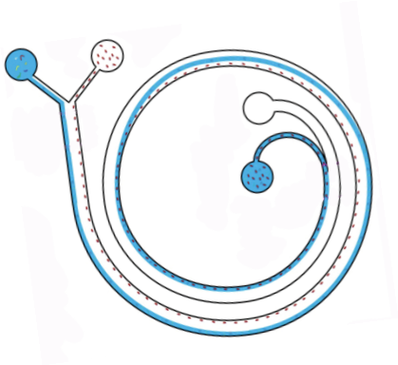















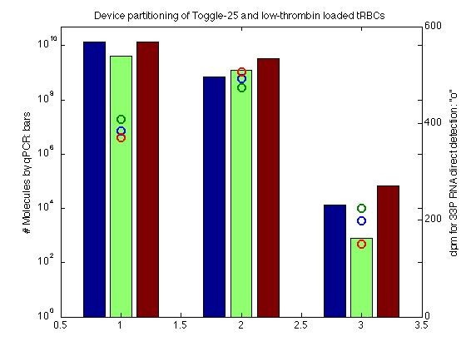
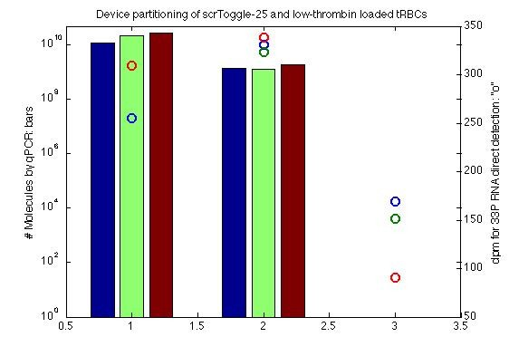
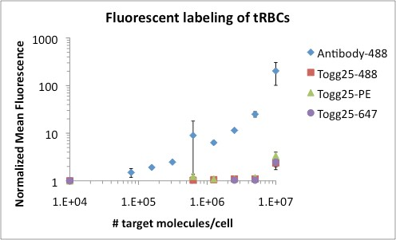



Microfluidic Aptamer Selections Against Malaria Targets
Christina M. Birch¹, Han Wei Hou², Jongyoon Han^{1,2}, Jacquin C. Niles¹
¹Department of Biological Engineering and ²Research Laboratory of Electronics, Massachusetts Institute of Technology
NSF GRFP
MIT/NIH Chemistry/Biology Interface Training Program
nileslab.mit.edu
Malaria cell surface antigens are attractive targets for diagnostics and interventions.
Inertial microfluidics allows for highly efficient and selective aptamer selections (I-SELEX).
Malaria-­‐infected red blood cells (iRBC) bind to host endothelia through speciﬁc ligand-­‐receptor interacHons.
Aptamers that bind to parasite ligands could enable disrupHon or monitoring of these binding events essenHal to disease pathophysiology.
Aptamer-­‐bound cells are washed with an inerHal-­‐microﬂuidic device that separates large targets (cells, beads) from parHcles in soluHon (unbound aptamers).
Aptamer-­‐bound cells are physically separated from unbound sequences at the device outlet:
96-well filter plate
Puriﬁed malaria-­‐infected RBCs:
Immobilized parasite adhesion proteins:
Gamain B et al. PNAS 2002;99:10020-10024
Immobilized parasite adhesion proteins:
I-­‐SELEX characteriza0on using a target (tRBC) and scaﬀold (sRBC) model cell system reveals a highly stringent washing method that does not require tagging, labeling, or immobiliza0on.
High Partition Efficiency Preferential Enrichment
PE ≥ 10⁶
Digital PCR allows for ampliﬁca0on-­‐based detec0on of < 10 recovered aptamers and is not inﬂuenced by PCR bias.
Using a single anH-­‐iRBC aptamer species, counHng the number of recovered molecules could provide an esHmate of the total number of a parHcular parasite epitope per cell.
Molecules/uL
12000
10000
8000
6000
4000
2000
0
Aptamer Neg Ctrl
CIDR
PMID: 3C64
DBLγ
PMID: 3BQK
Amplification-based detection methods are necessary for quantifying aptamer recovery.
1
100 10000 1000000
Dilu0on Factor
Partition Efficiency (PE) is the metric used to Using biased aptamer libraries consisting of 99%
evaluate method stringency and is defined as (left bars) or 90% (right bars) scrambled
PE = # Input molecules / # Outlet molecules aptamer, we demonstrate the device is able to
(1)
using a nonbinding aptamer pool (right bars).
preferentially enrich for tRBC binding thrombin aptamer.
sRBC
sRBC
Cell-­‐binding aptamers can be iden0ﬁed through protein binding assays when available (BioLayer Interferometry, below).
Association Dissociation ^{Association Dissociation}
Binding of ﬂuorescently labeled aptamers can be visualized by ﬂow cytometry when there are suﬃciently high numbers of surface target present.
(5)
(2)
Toggle-25
Cell count
250
200
150
100
50
tRBC sRBC
Capture Oligo scrToggle-25 Toggle-25
5-12
Inertial SELEX
scrToggle25
0
tRBC
Binding kinetics are shown for library pools from each round of selection (above left) as well as detailed analysis of one high affinity clone, 5-12 (above right). The conserved sequence motif and mfold secondary structure prediction for 5-12 are shown (below).
10¹ 10² 10³ 10⁴ 10¹ 10² 10³ 10⁴
Fluorescent Signal (RFU)
5-12 and Toggle-25 show preferential binding to tRBCs over sRBC whereas scrToggle-25 and the fluorescent Capture Oligo showed no binding (above).
(4)
(3)
tRBC
I-SELEX can target purified proteins, lab strains, selected lines, field isolates, or a combination.
Malaria-iRBC
tRBC
aptamers could
enable:
Imaging of sequestered iRBCs.
Aptamer-­‐bound cells washed with the microﬂuidic device retain too few aptamers to be directly detected by radioacHvity (circles) but can be quanHﬁed by qPCR (bars).
Bead- immobilized proteins
Recombinant CIDR or DBLγ
Thrombin model system
Malaria iRBCs
Disruption of host-iRBC binding interactions.
For targets on the red blood cell surface, ﬂuorescent detecHon is restricted to cells presenHng more than 10⁶-­‐10⁷ molecules/cell.
CS2
Non- switching
HBEC
selected lines
Gametocytes
Proteomics identification of surface antigens.
3D7
variant lab strain
3D7-HBEC
HB3-HBEC
Determination of number of parasite surface proteins.
Field isolates?
References:
  Birch et al. Sci Rep. 5, 11347.

